Slide 1
System Identification of Longitudinal Dynamics of a Multirotor UAV
Estimation and Learning in Aerospace – Exam Project
Professor: Marco Lovera
Luca Frassinella, Gianluca Scudier

Slide 2

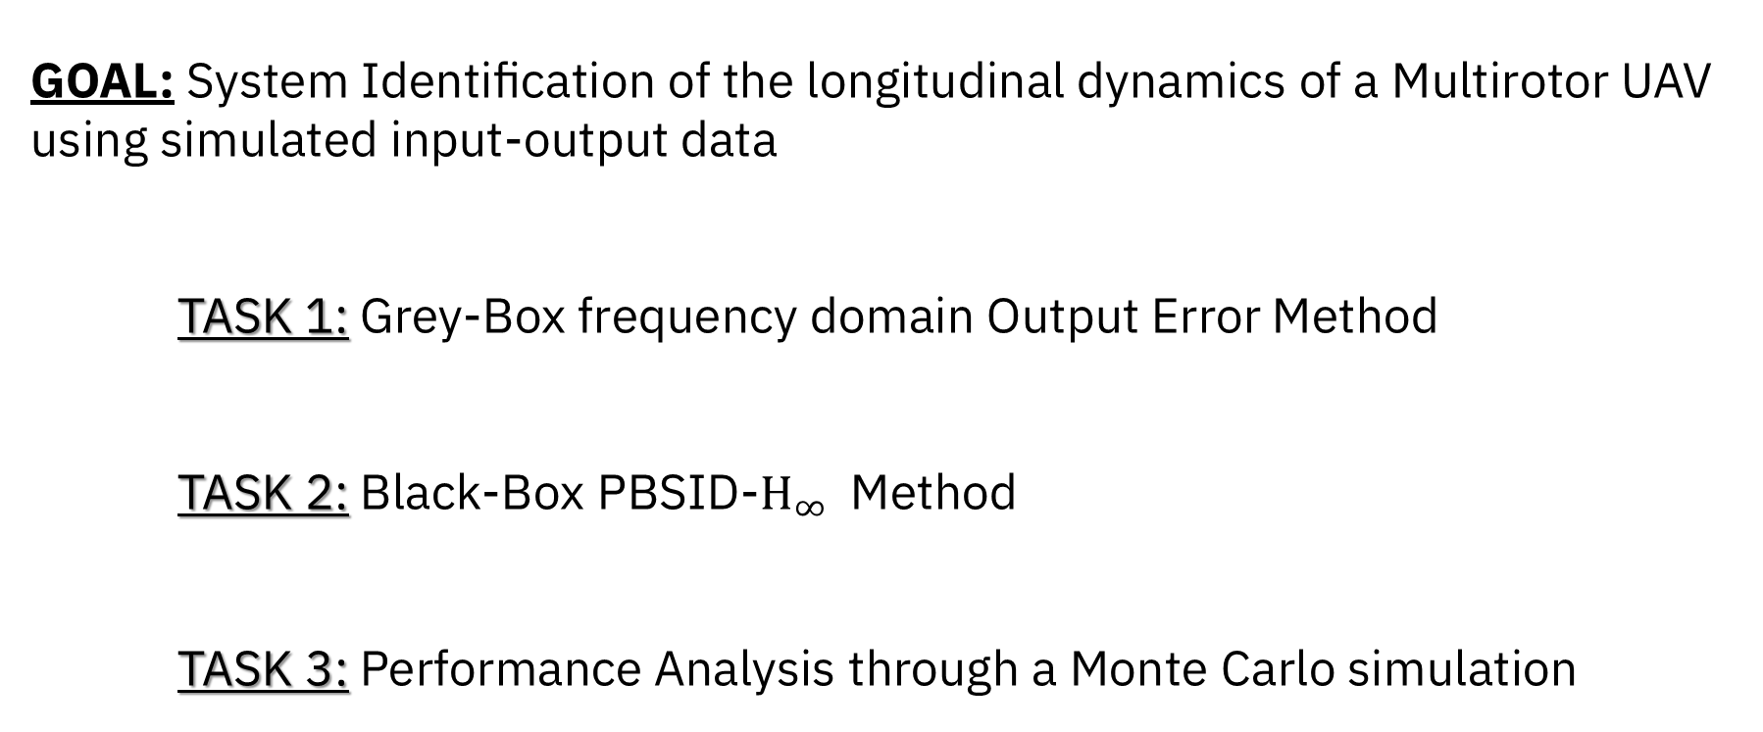
Project Objectives
GOAL: System Identification of the longitudinal dynamics of a Multirotor UAV using simulated input-output data
TASK 1: Grey-Box frequency domain Output Error Method
TASK 2: Black-Box PBSID-$H_{∞}$ Method
TASK 3: Performance Analysis through a Monte Carlo simulation

Slide 3
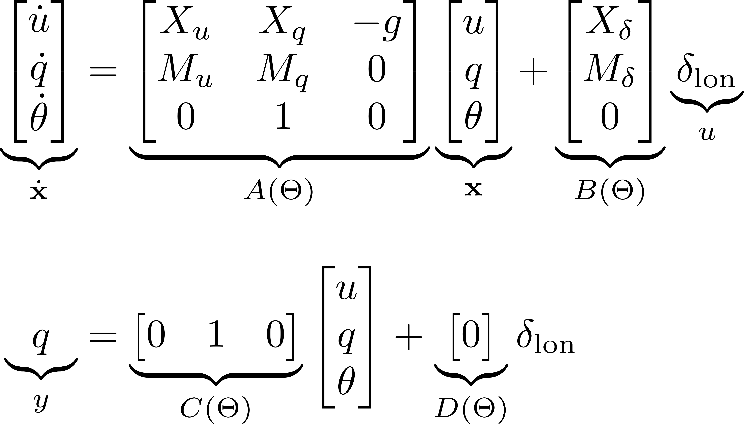
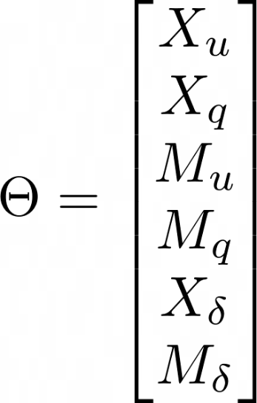
Linearized Model
Linearized Longitudinal Dynamics Model:
Model Parameters:
Model Class:

Slide 4
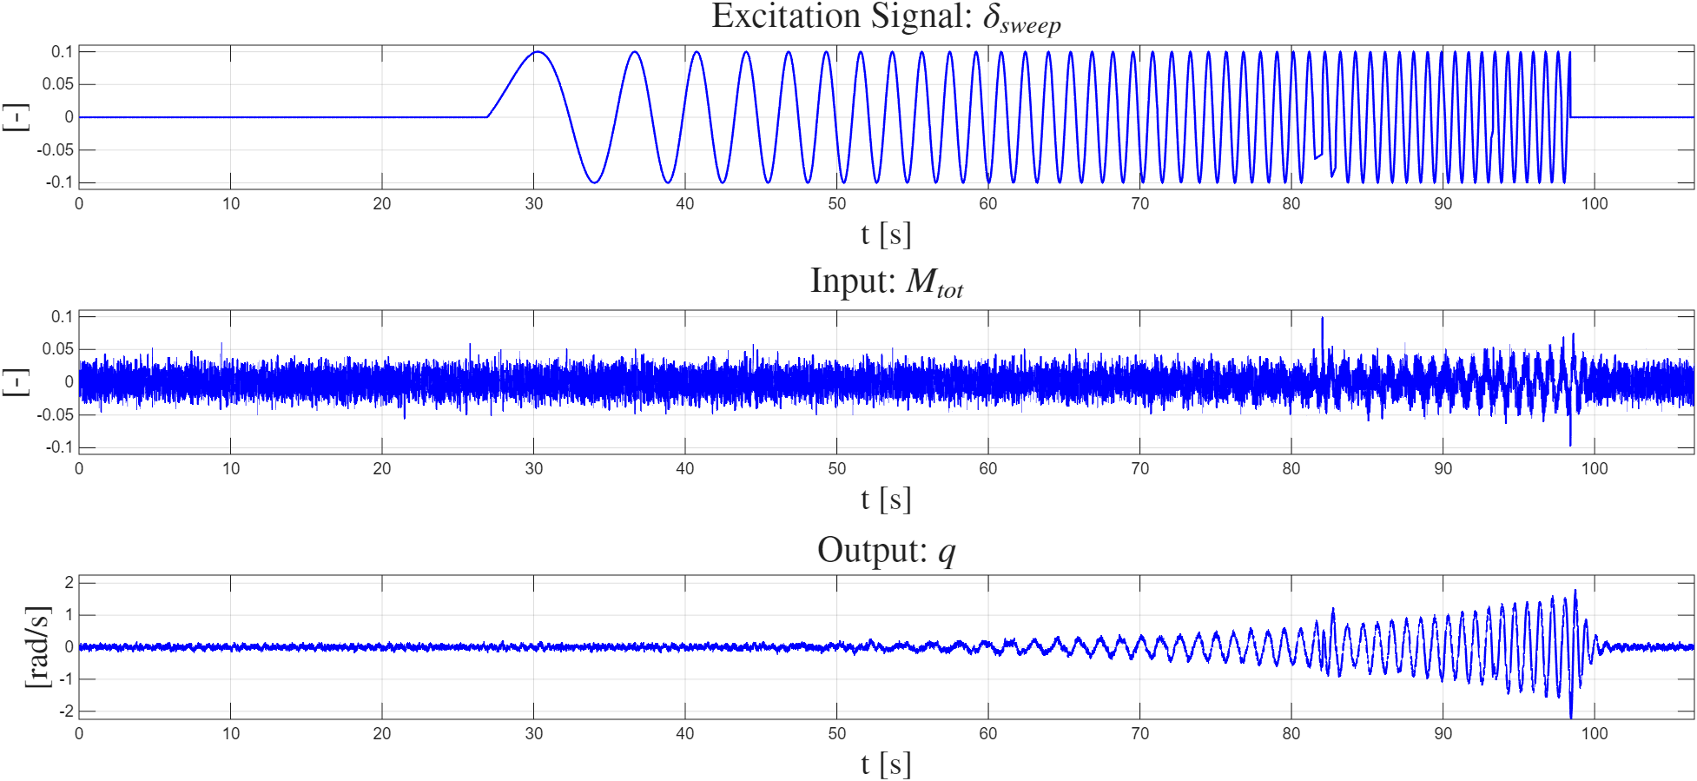
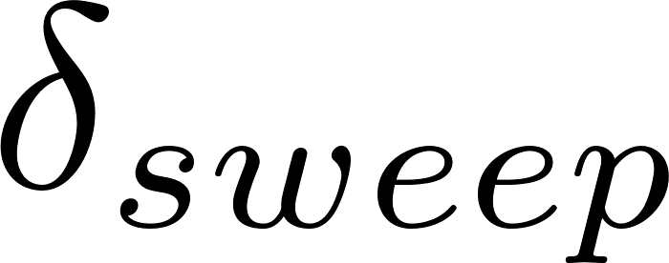
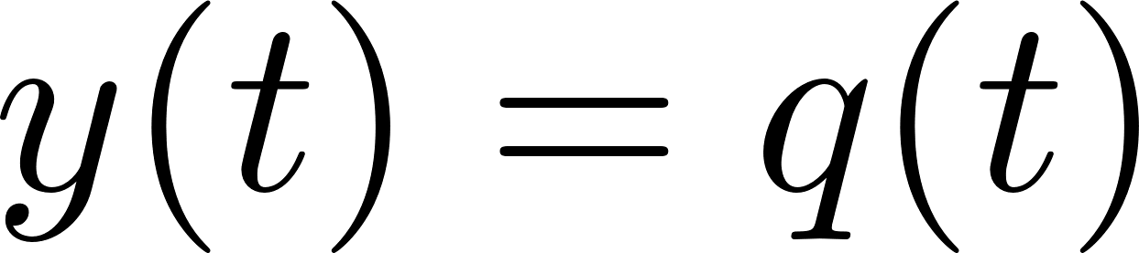
Input-Output Data
Longitudinal dynamics are unstable closed loop identification experiment
Excitation signal Sinesweep
Input Total pitch moment
Output Pitch rate

Slide 5
TASK 1:
Grey-Box Model Identification

Slide 6
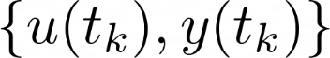
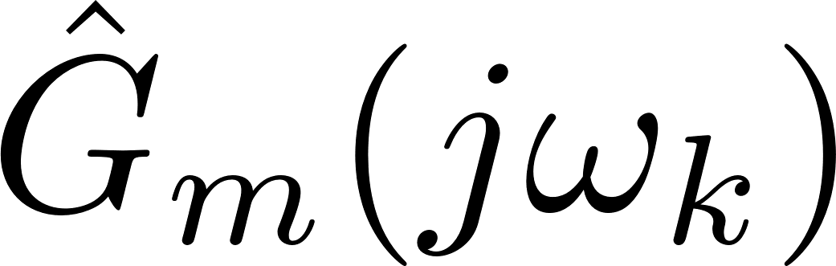


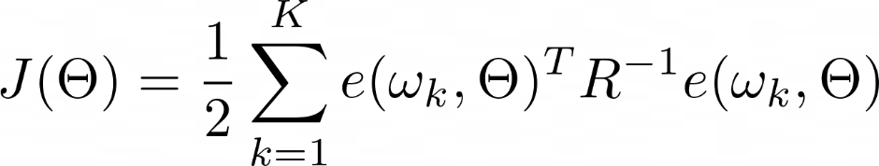
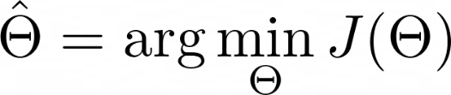
T1.1 Frequency Domain OE Method
From measured input-output data:
From model class:
Estimated FRF:
Model FRF:
Stack FRFs in a vector:
Model Error:
Cost Function:
greyest

Slide 7
T1.1: Implementation
To reduce the variance of the estimated parameters and have better convergence:
Data Prefiltering
Estimation of non-parametric FRF (Welch Method) from filtered data
Grey-Box Identification with greyest
Post-Processing of the results

Slide 8
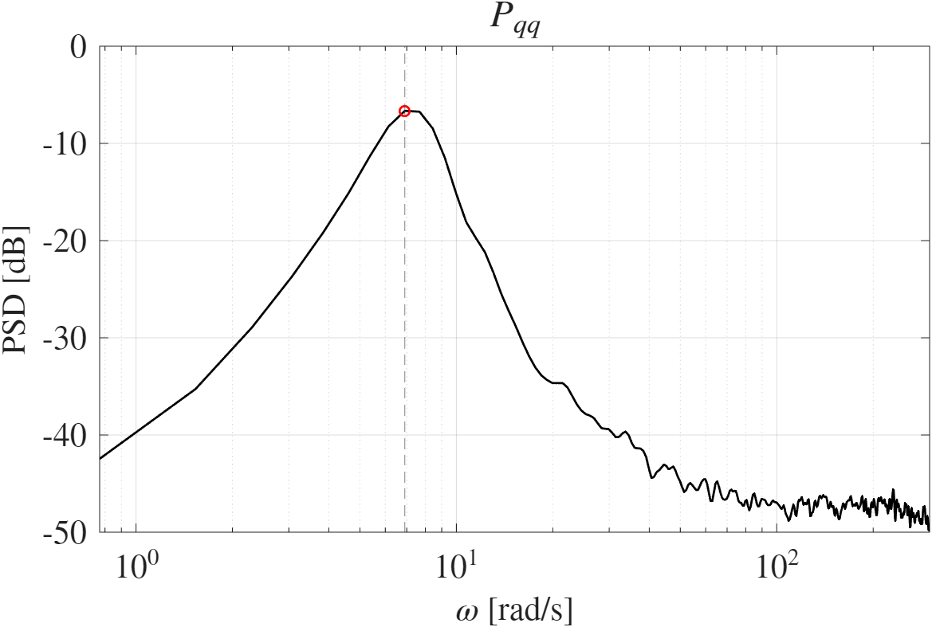
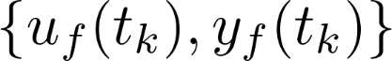
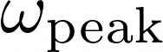
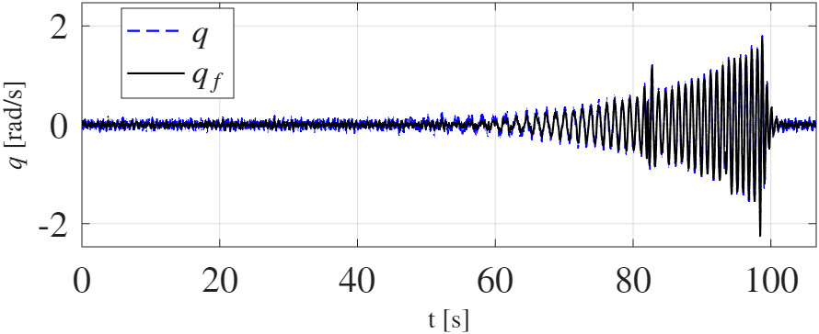
T1.1: Data Prefiltering
4-th order Butterworth Pass-Band
Filter around gggggggg
of the estimated output PSD
Goal: reduce measurement noise

Slide 9

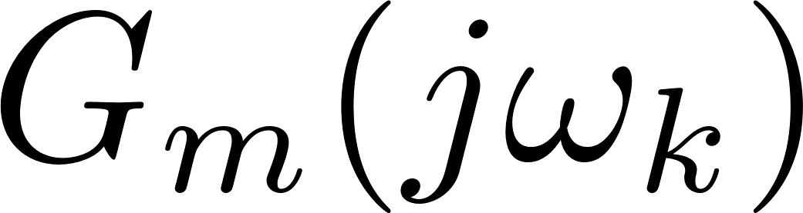
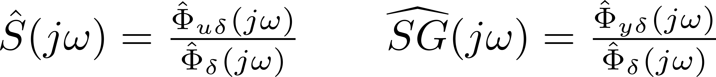
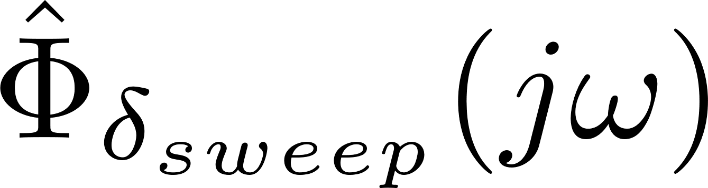

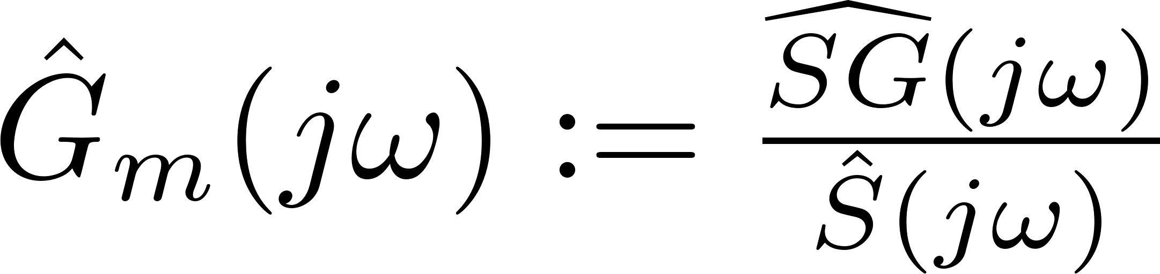
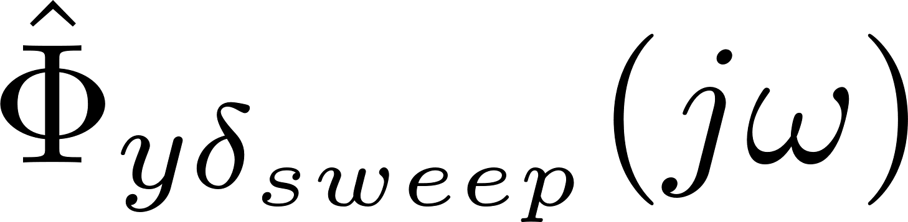
T1.1: Non-Parametric FRF
To run greyest in the FD we need to estimate the FRF from I/O data
Option #1:
Option #2: estimate from filtered I/O using Welch’s Method (averaging + windowing)
fft
Very high asymptotic variance of the estimates
iddata
Since the system is operating in closed loop
We use the unbiased estimator formulation used in ^{[5]}:
pwelch
cpsd
cpsd

Slide 10
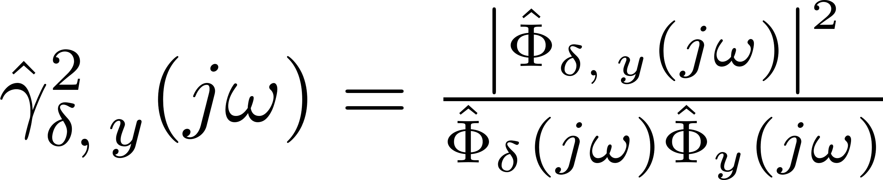
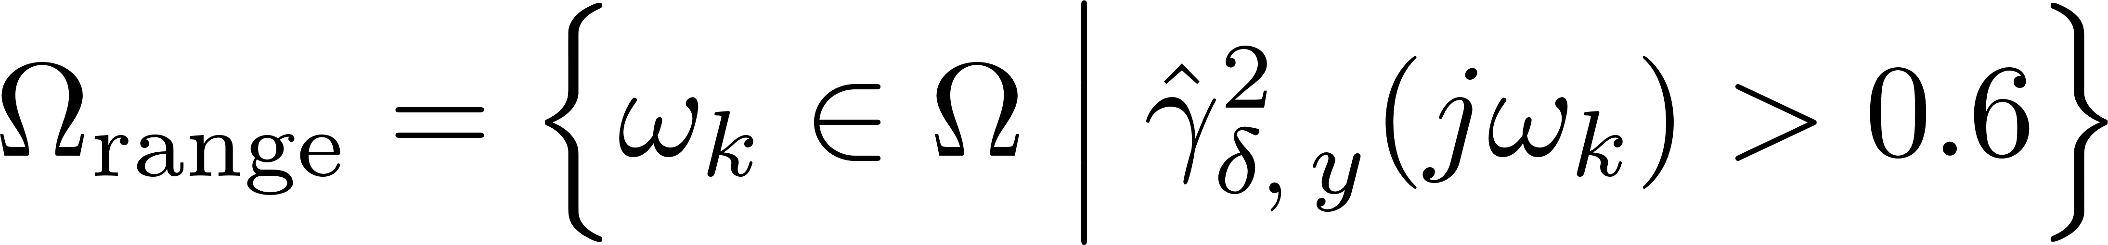
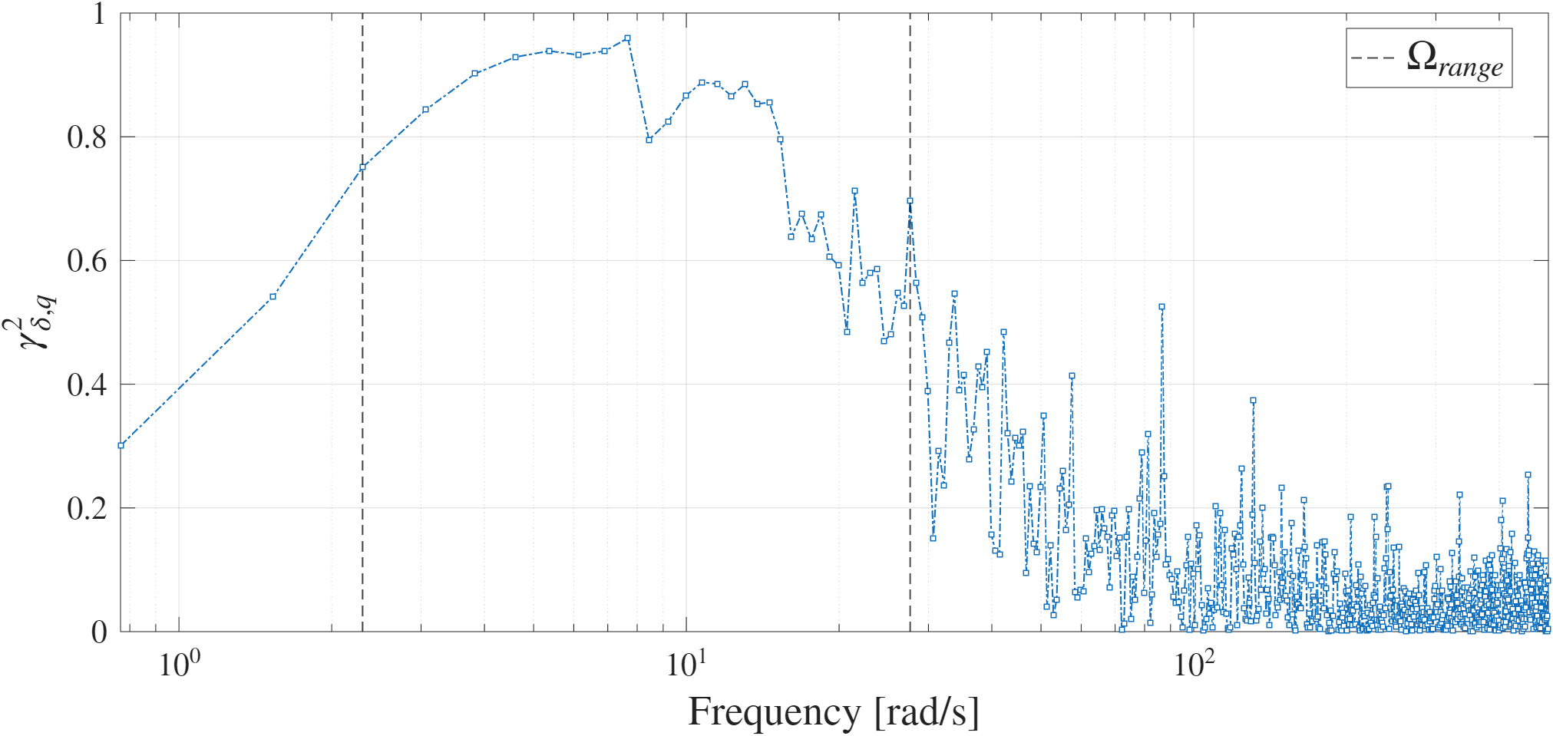

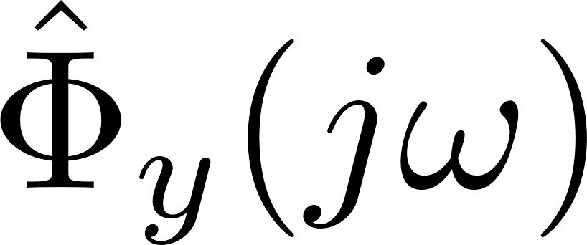
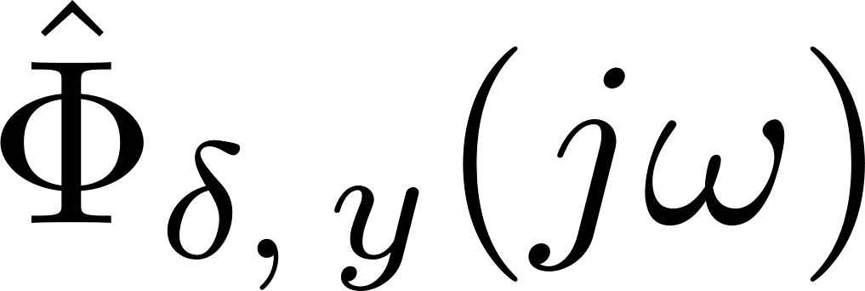
T1.1: Coherence Function
The frequency range for the greyest cost function was selected based on the estimated coherence between the excitation signal and the output.
We use the consistent estimator ^{[5]}:
pwelch
pwelch
cpsd

Slide 11
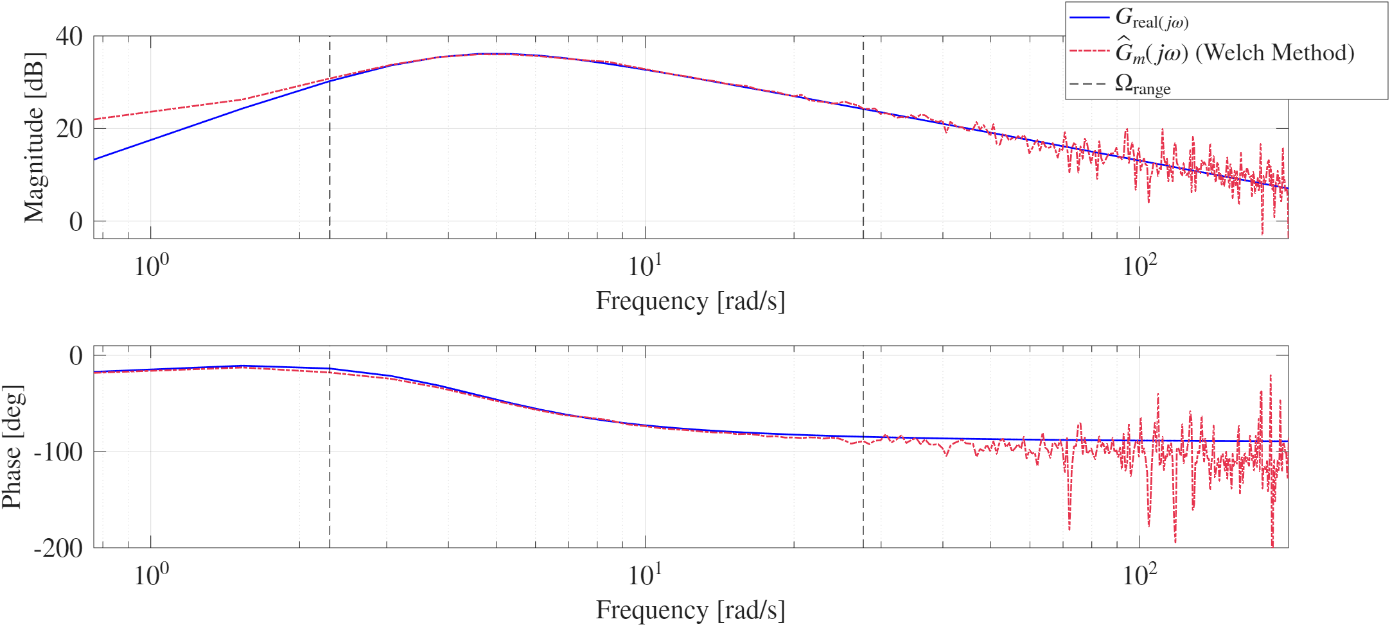
T1.1: Non-Parametric FRF

Slide 12
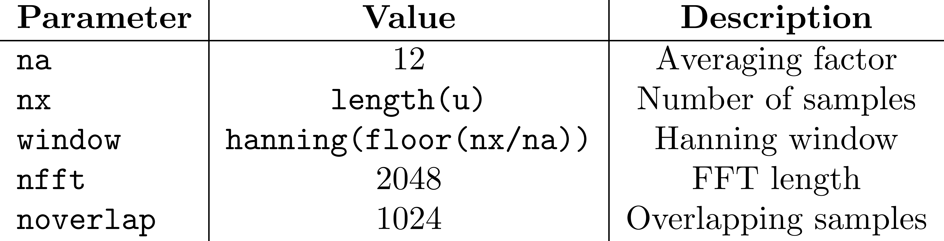
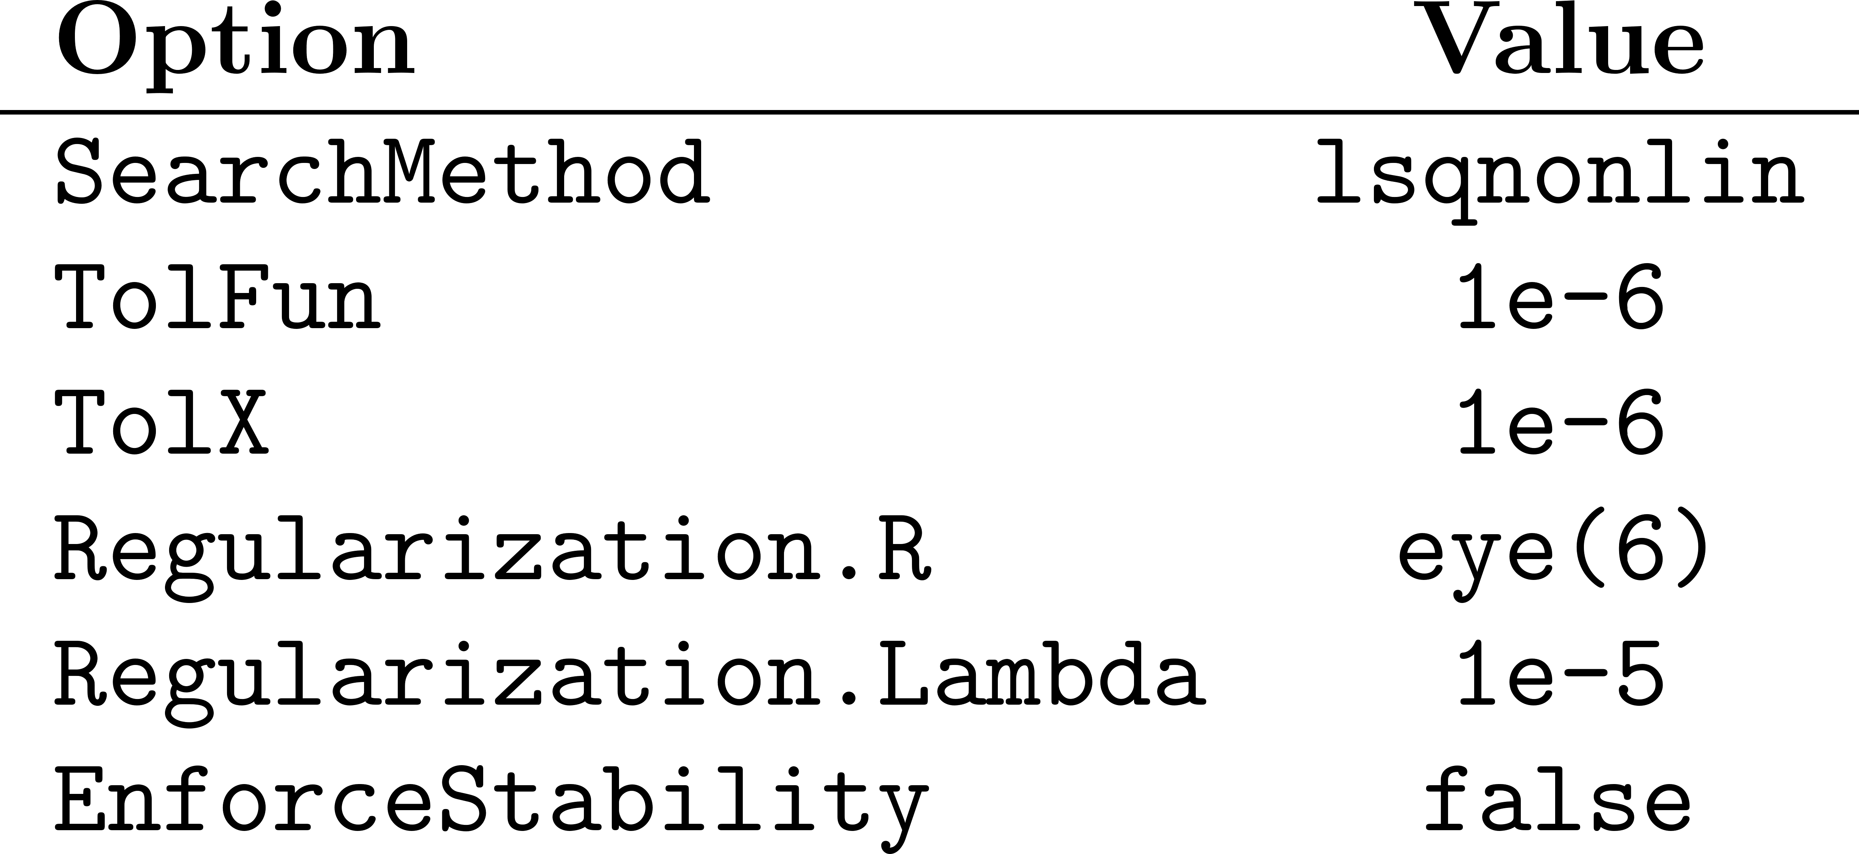
T1.1: MATLAB implementation
Non-Parametric FRF Estimation (Welch):
greyest options:

Slide 13
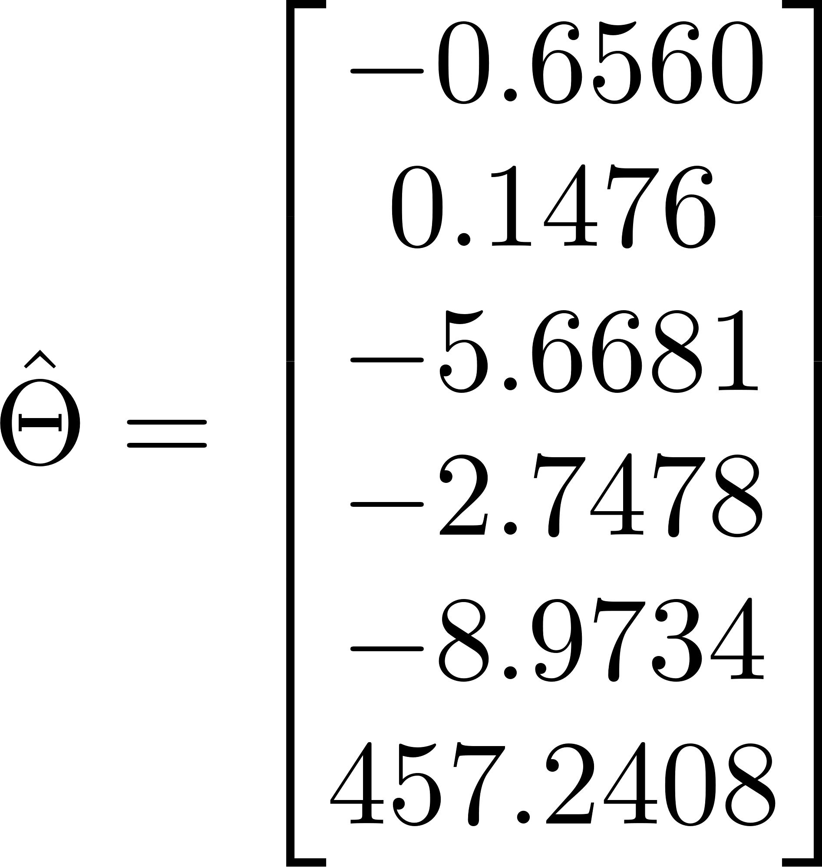
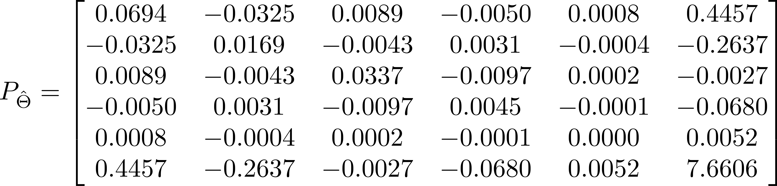
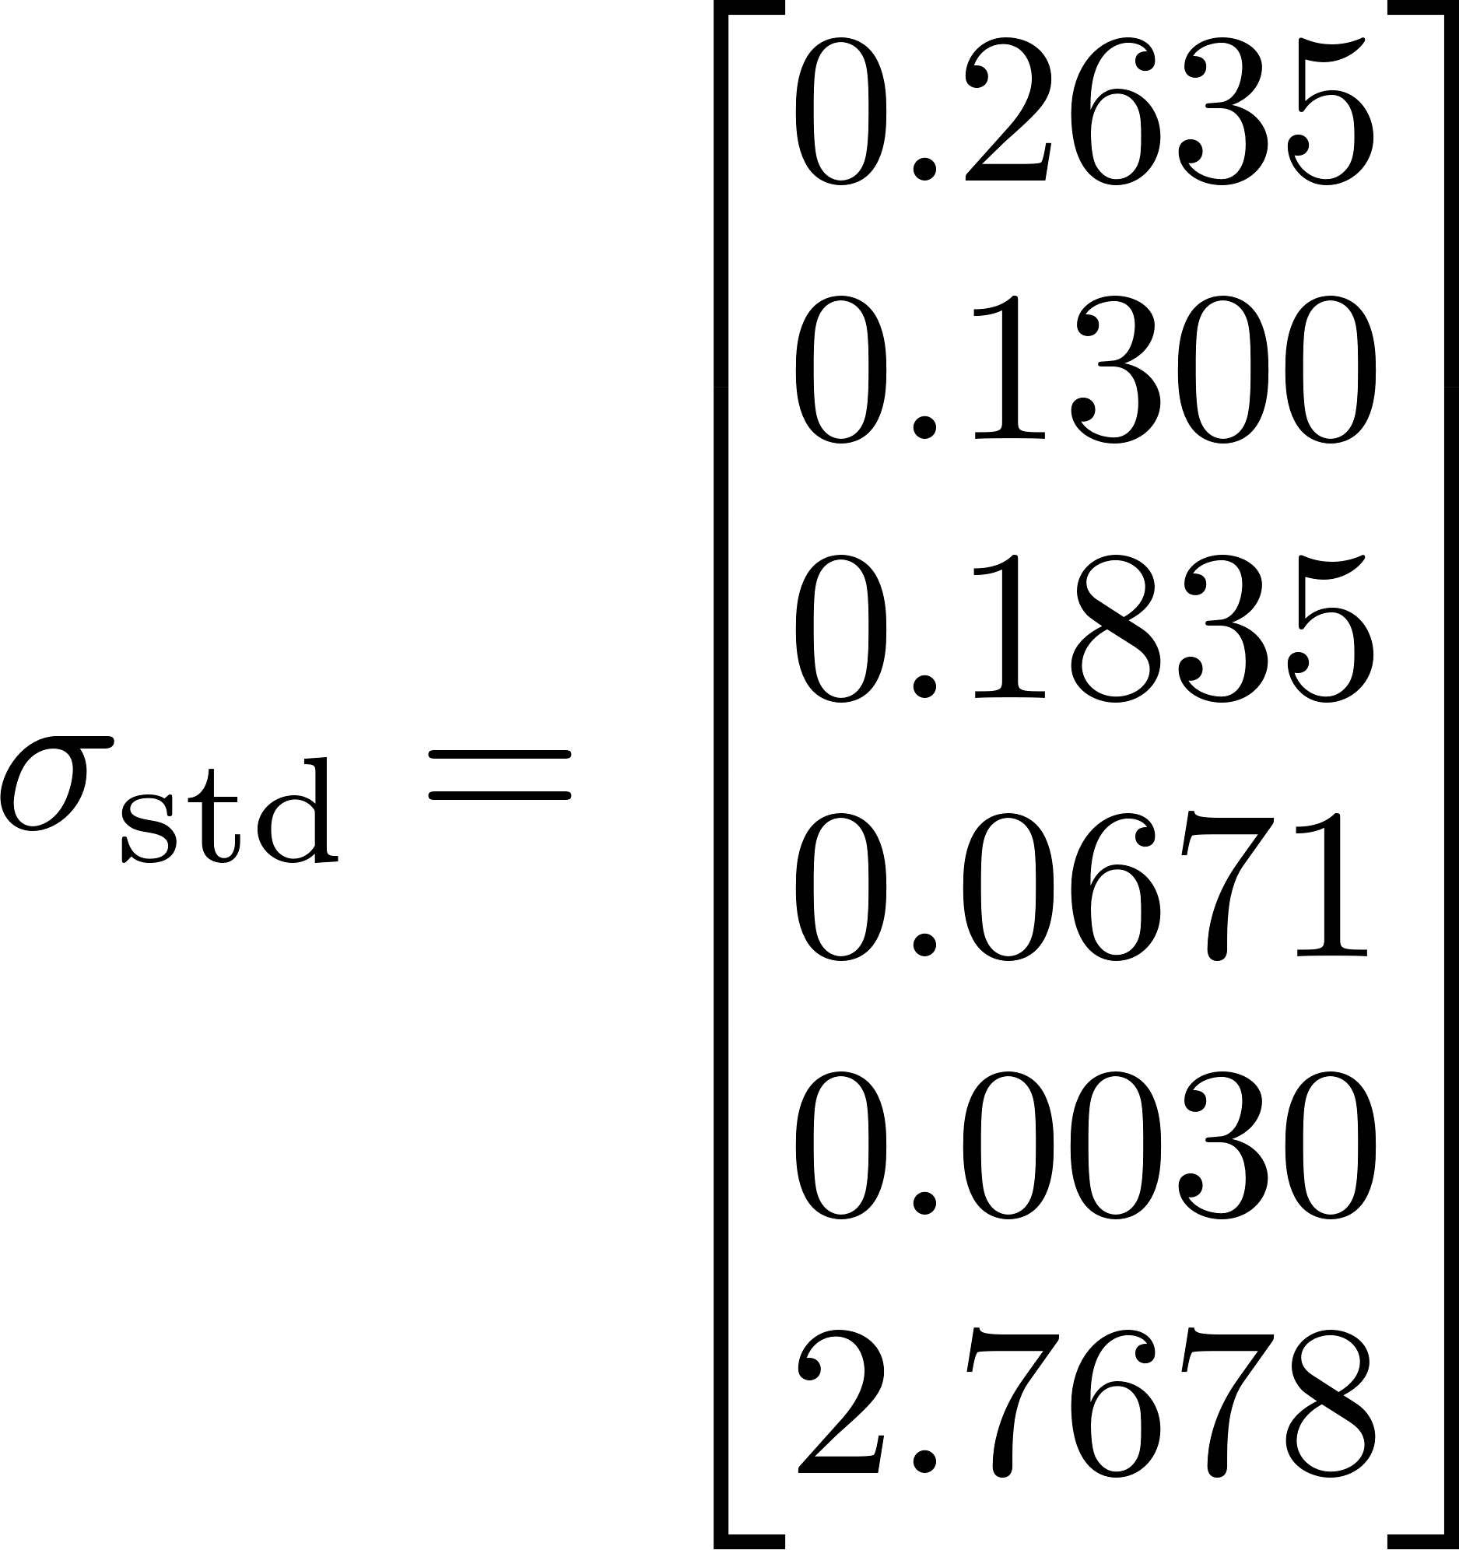
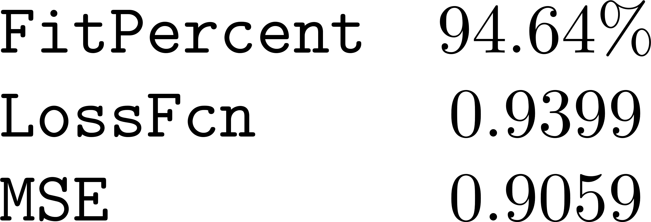
T1.1: Identification Results
Optimal Parameters:
Parameter Covariance Matrix:
greyest report:
Standard Deviations:

Slide 14
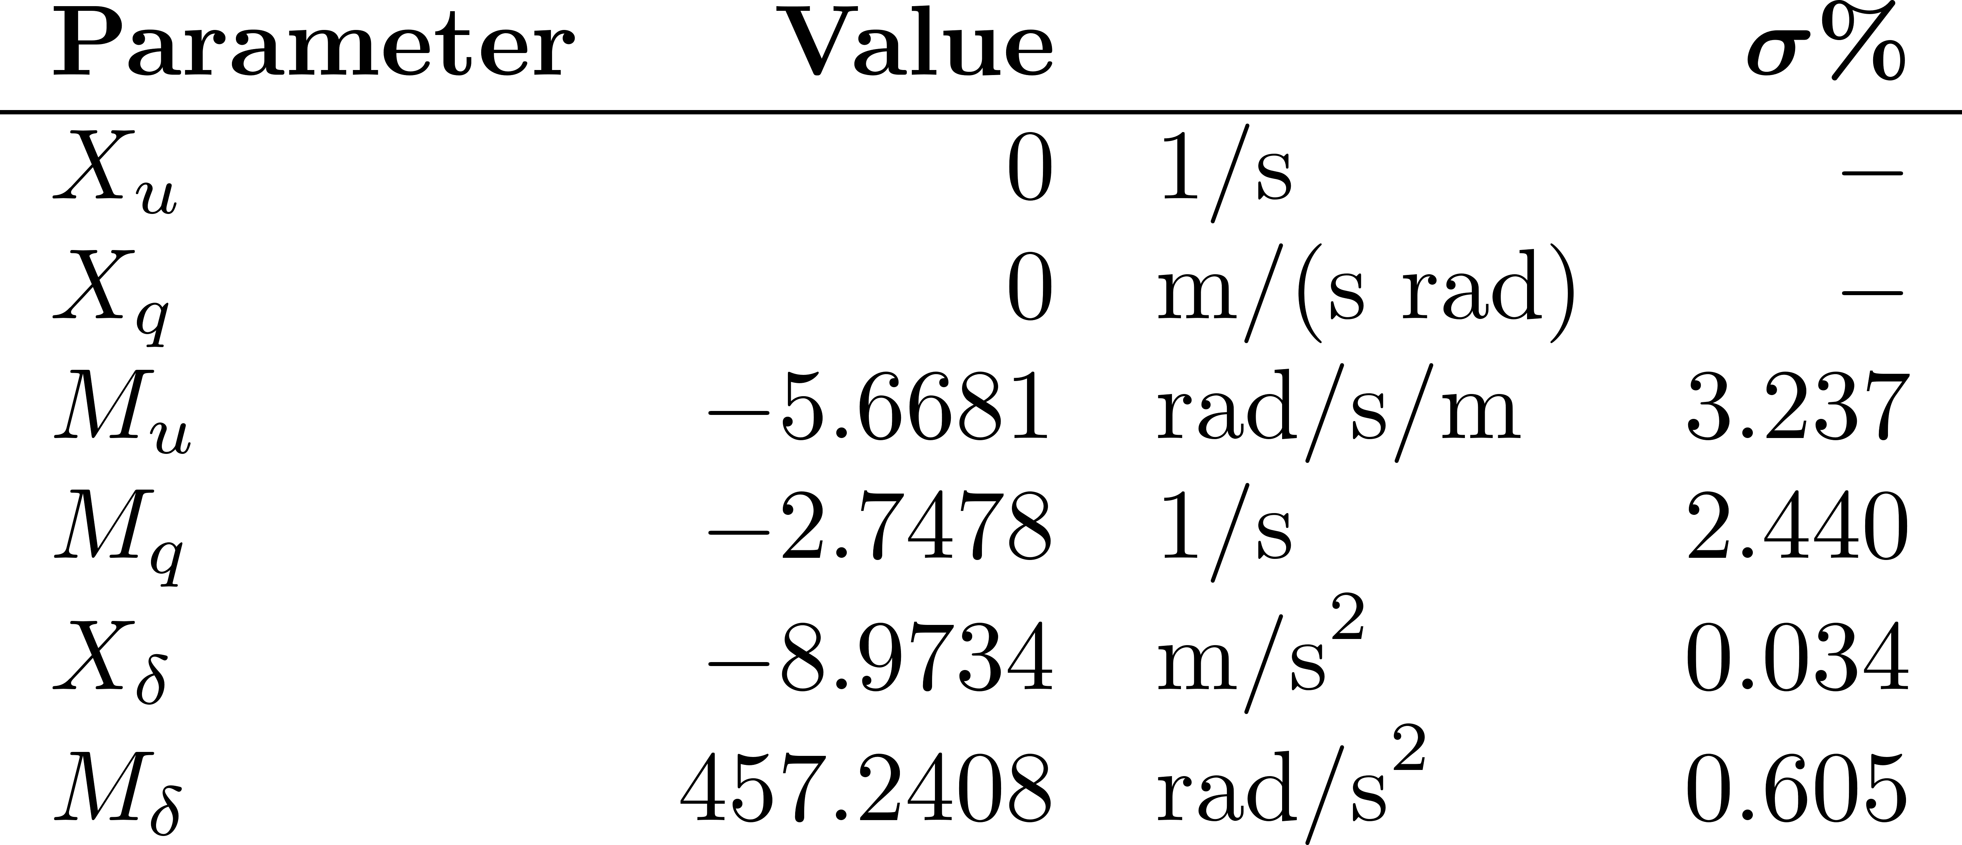
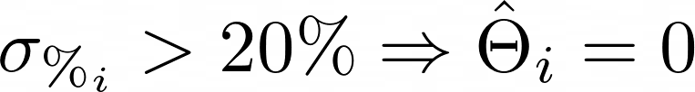
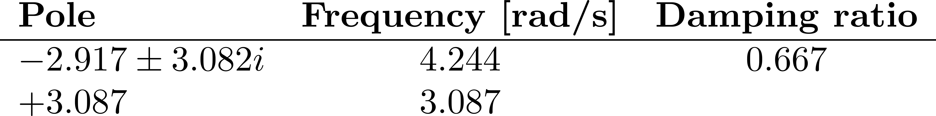
T1.1: Identification Results (with Post-Processing)
Some parameters are fixed in post-processing:

Slide 15
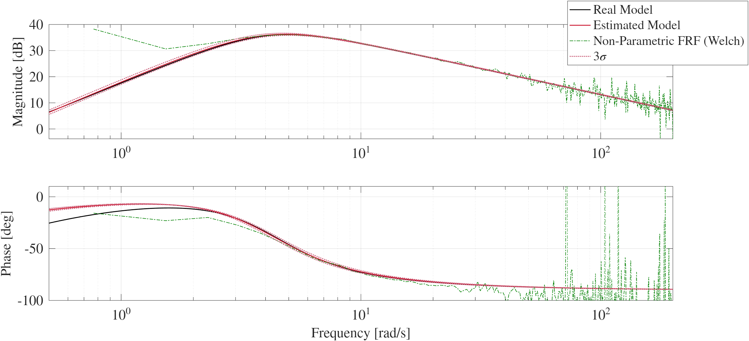
T1.1: Bode Plots

Slide 16
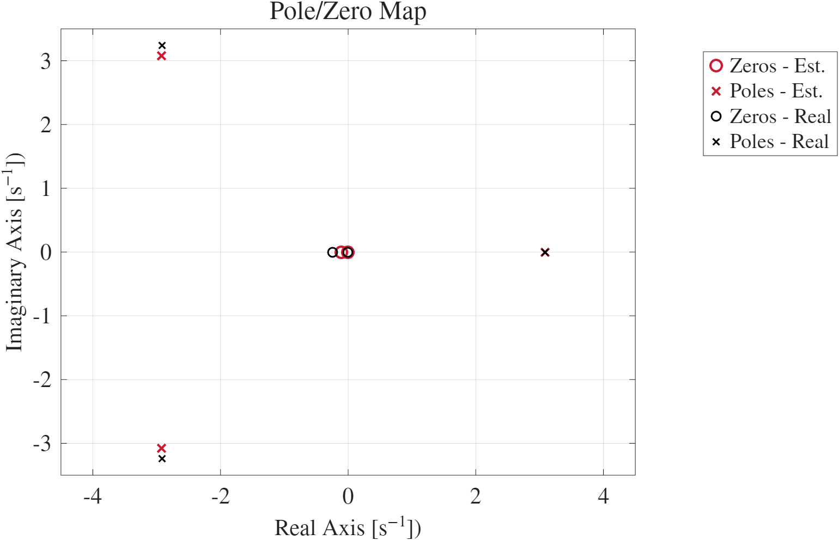
T1.1: Pole-Zero Map

Slide 17

T1.2: Asymptotic Variance
In the Maximum Likelihood framework, the asymptotic covariance of the estimated parameters is given by the inverse of the Fisher information matrix:
Using greyest, the asymptotic variances of the parameters are the diagonal elements of the covariance matrix:

Slide 18
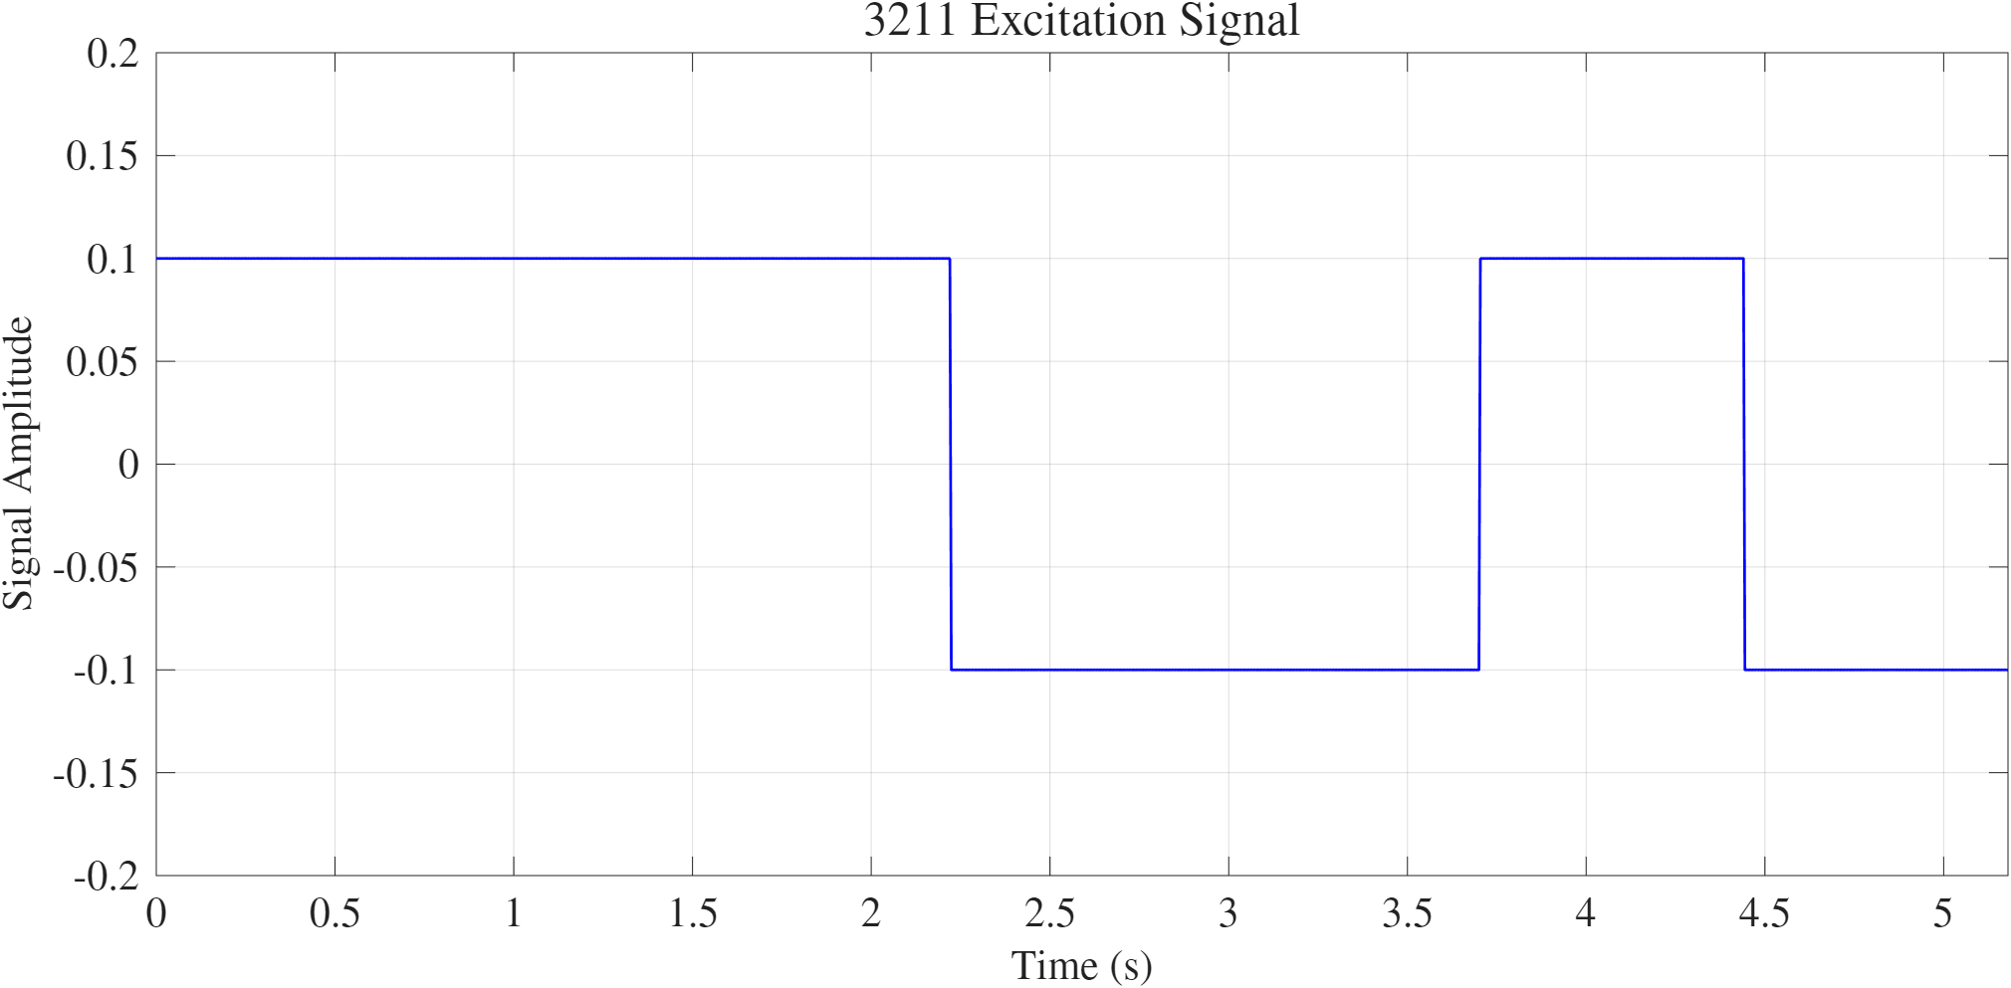
T1.3: Model Validation
Time scale of the 3211 sequence was chosen as half the period of the dominant mode of the estimated system ^{[7]}:

Slide 19
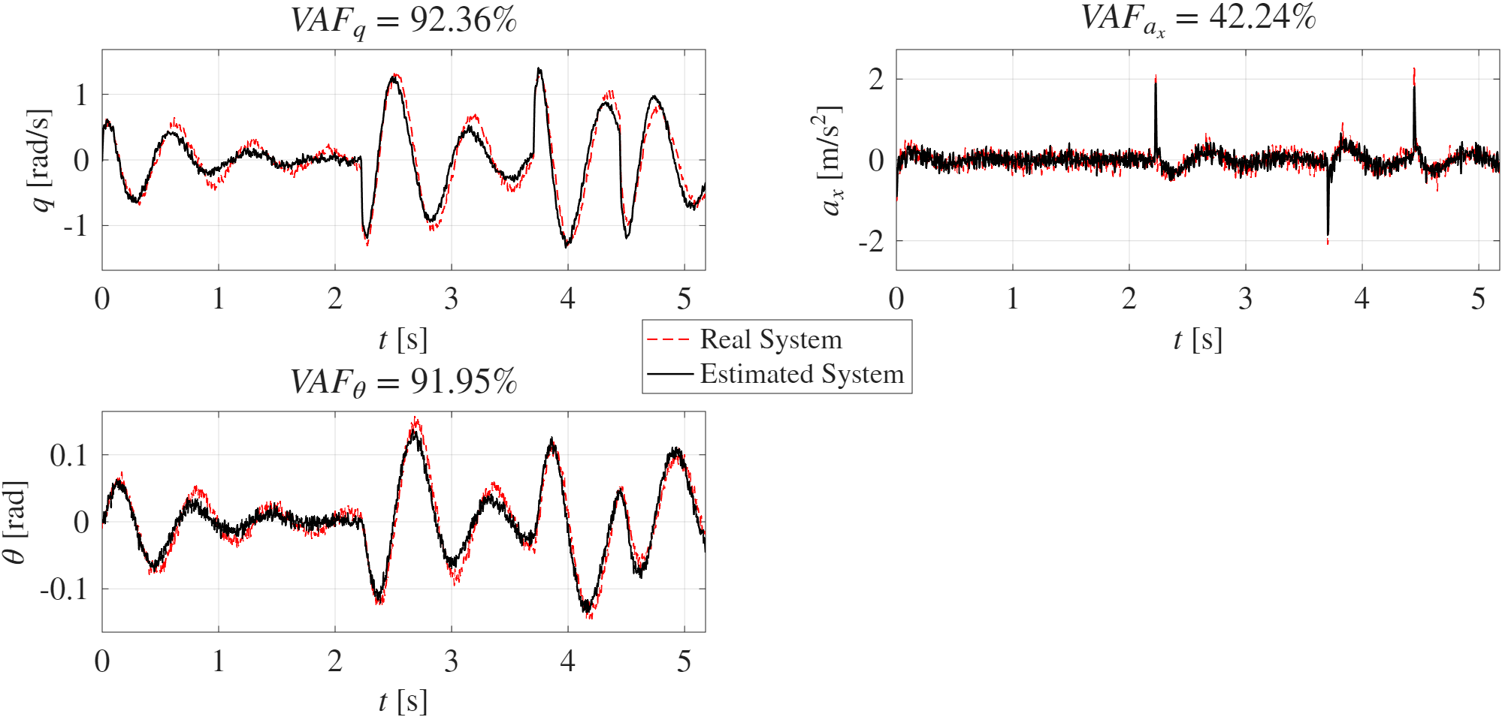
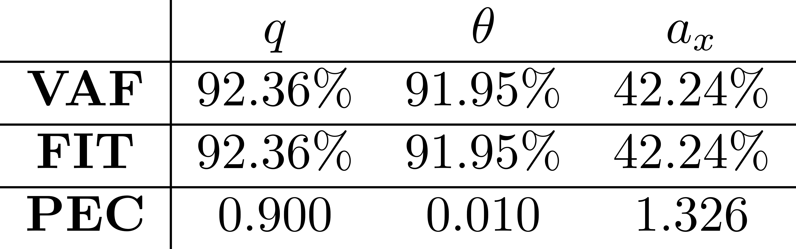
T1.3: Model Validation
Validation results:

Slide 20
TASK 2:
Black-Box Model Identification

Slide 21
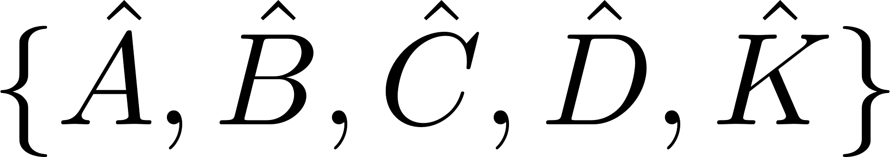
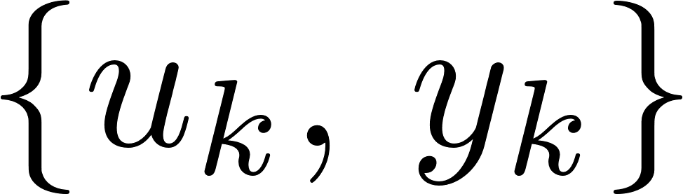
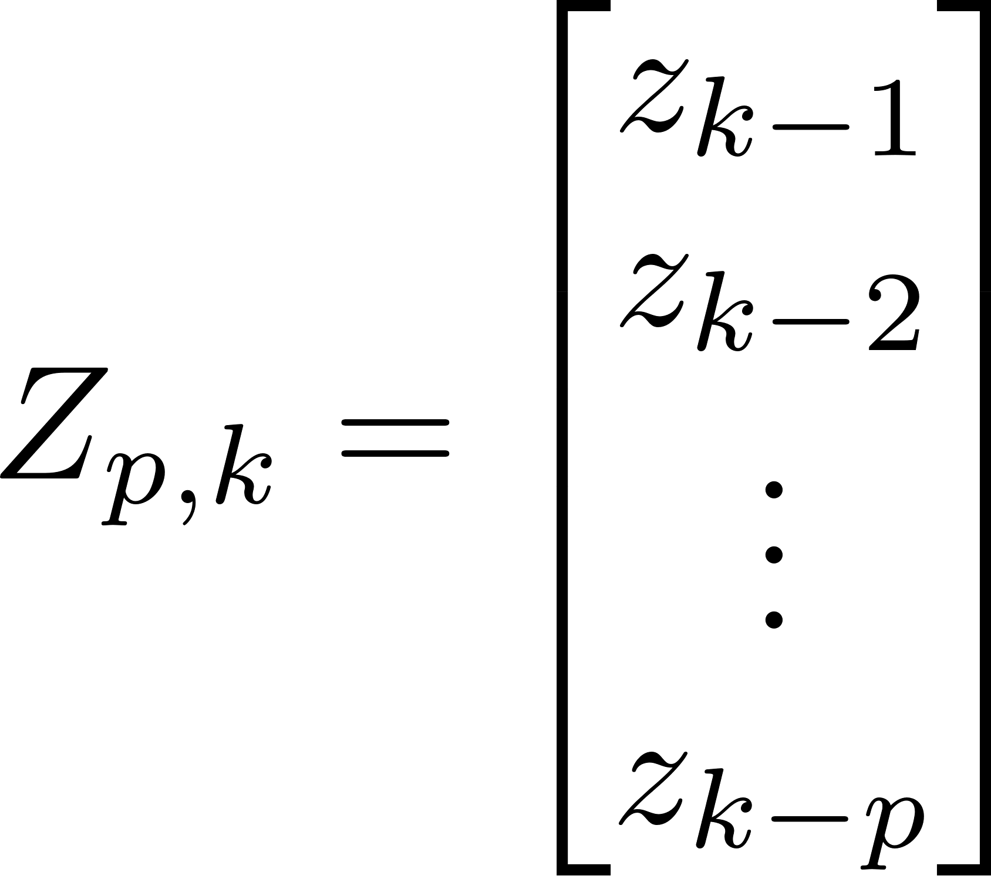
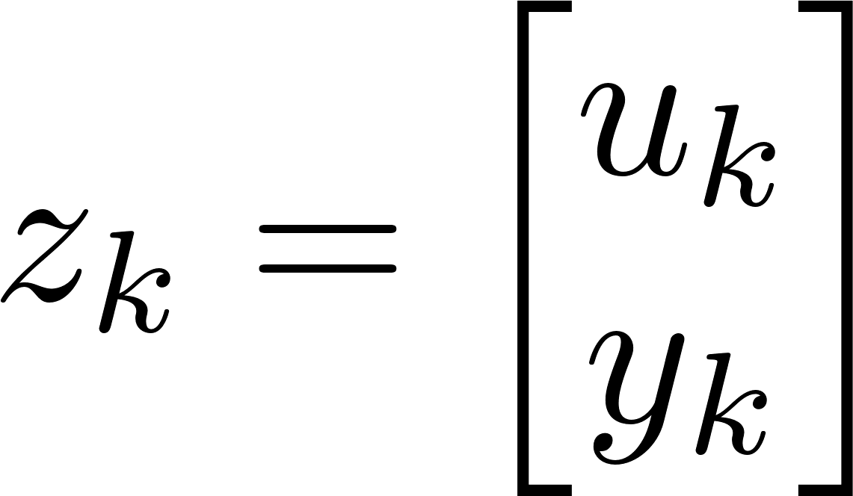
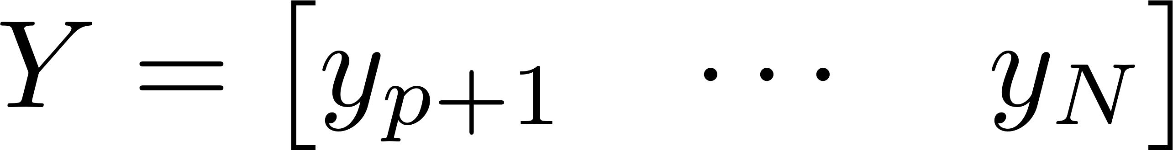
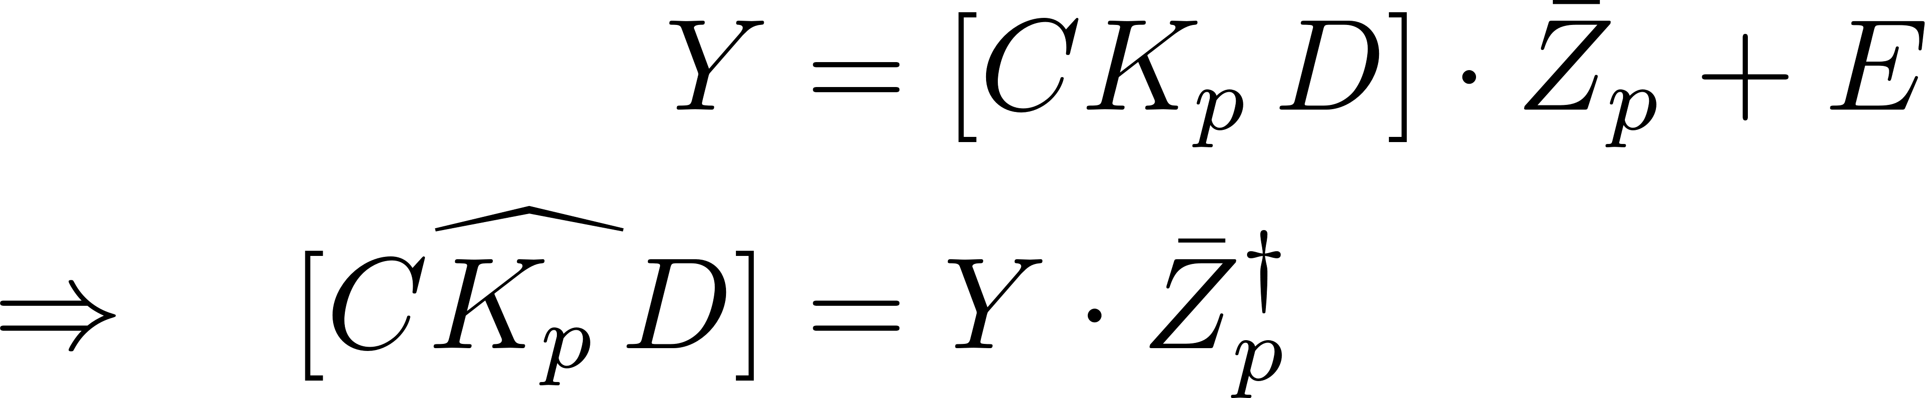
T2.1: PBSID Algorithm
Goal: given a dataset of sampled I/O Estimate the system matrices:
Predictor Based Subspace Identification:
Step #1: First Least Squares Regression from:
From:
Assemble:
Solve the LS regression:

Slide 22
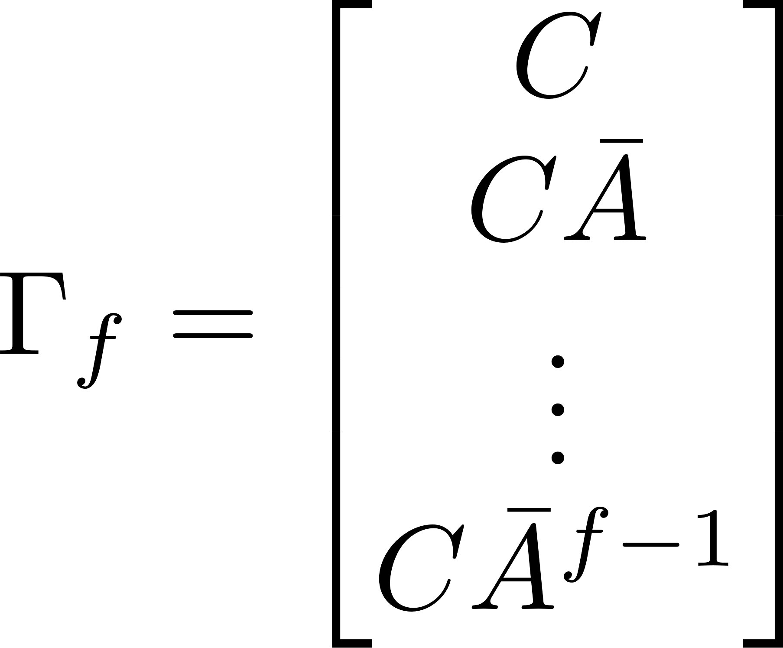
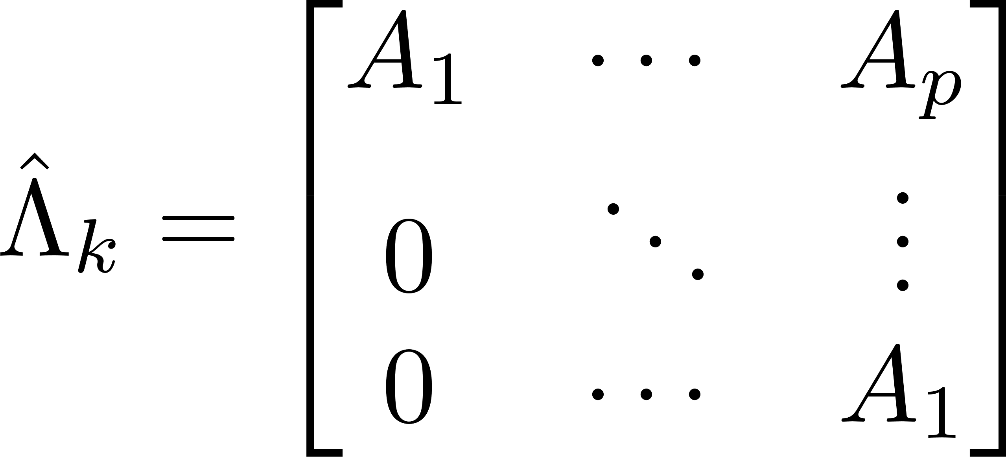
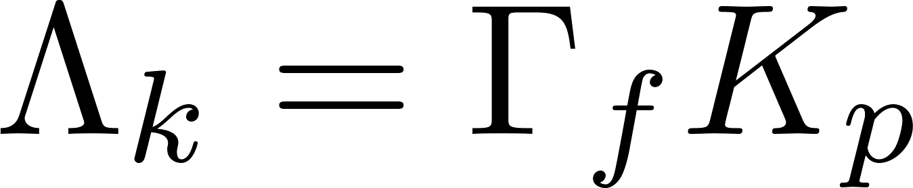
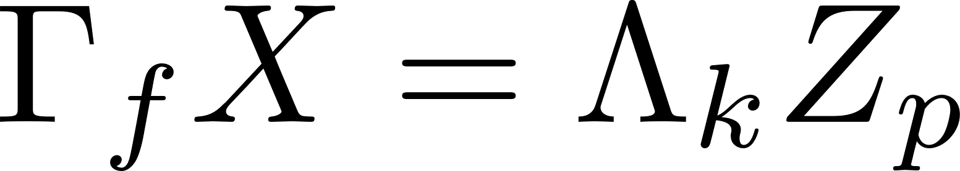
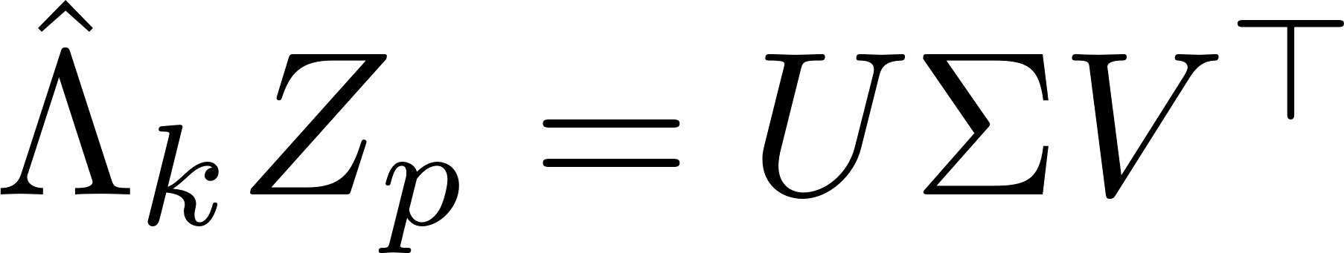


T2.1: PBSID Algorithm
Step #2: Assemble the matrix of Markov Parameters
From the estimated VARX coefficients:
We construct:
Step #3: Estimate the state sequence
From:
Then (by properly choosing looking at the singular values):
SVD

Slide 23





T2.1: PBSID Algorithm
Step #4: Estimate the system matrices:
From the output equation:
Estimate of the innovation error sequence:
From the state equation:
parameters to be tuned:

Slide 24







T2.1: H$∞$ Model Matching
from PBSID:
Model Class:
To retrieve the physical parameters (using transfer functions):
+
-
To focus the matching in the frequency range where the unstructured model best describes the real system, we include a pass-band filter:

Slide 25




T2.1: $H_{∞}$ Model Matching
The problem is solved in Matlab in two steps ^{[5]}:
Step #1: systune (preprocessor) used to provide a reliable
- Allows the matching to be focused in a specific band
- Possible to remove the stability constraint
Step #2: hinfstruct performs the $H_{∞}$ model matching starting from
- Pass-band filter to focus on the relevant frequency range
parameters to tune:

Slide 26









T2.2: Algorithm Validation (SMD system)
Example: series of two spring-mass-dampers State-Space:
Input: random force ($F$)
Output: position of mass 1 ($s_{1}$)
Known parameters:
Unknown parameters:

Slide 27




T2.2: Algorithm Validation (SMD system)
PBSID-$H_{∞}$ with:

Slide 28


T2.3: Tuning of $p, f, n$
To run the PBSID we need to tune {p, f, n} Problem: TD cross-validation cannot be done with lsim because the system is unstable
Solution: Validation in the frequency domain using the non-parametric estimates of

Slide 29





T2.3: Tuning of $\{p, f, n\}$

Slide 30



T2.4: Tuning of $\{ω_{1}, ω_{2}, N\}$
To run the $H_{∞}$ model matching algorithm we need to tune the pass-band filter parameters $\{ω_{1},ω_{2}, N\}$, using the last part of the dataset as cross-validation and selecting the values that maximise the VAF between estimated and measured systems:

Slide 31



T2.4: Tuning of $\{ω_{1}, ω_{2}, N\}$

Slide 32




T2: Identification Results
with

Slide 33







T2: Variances of estimated PBSID-$H_{∞}$ parameters
From TU Delft PBSID Toolbox dvar4abcdk: function that estimates the asymptotic variances of the unstructured identified model
PBSID
dvar4abcdk
As. Var. of state space model
Monte Carlo distribution of est. physical parameters
M = 20’000 random unstructured models
$H_{∞}$ structuring
The expectation and standard deviations of each parameter is evaluated through:

Slide 34


T2: Variances of estimated PBSID-$H_{∞}$ parameters

Slide 35

T2: Bode Plots

Slide 36

T2: Pole/Zero Map

Slide 37


T2.5: Model Validation
Validation results:

Slide 38
TASK 3:
Monte Carlo Analysis

Slide 39





T3.1: Model Comparison – Estimated Parameters
Grey-Box System Identification (T1):
PBSID-$H_{∞}$ System Identification (T2):
Relative errors comparison:

Slide 40


T3.1: Model Comparison – Poles and Zeros
Grey-Box System Identification (T1):
PBSID-$H_{∞}$ System Identification (T2):
Euclidean distances between estimated and real poles/zeros:

Slide 41


T3.1: Model Comparison – Bode Plots

Slide 42




T3.2: Monte Carlo Analysis on noise realisations
The Monte Carlo Analysis has been carried out changing the seed structure inside the Simulink model, obtaining different realisations of the noise processes
$N$ has been set to 1000 in order to balance statistical meaning of the obtained distribuitions and computational effort
Step #1: Simulate $N$ Simulink models with different seed, obtaining $N$ different datasets:
Step #2: Perform model identification following the procedures of Task 1 and Task 2:

Slide 43


T3.3: MC Results – Est. Parameters (T1)

Slide 44


T3.3: MC Results – Est. Parameters (T2)

Slide 45


T3.3: MC Results – Poles (T1)

Slide 46


T3.3: MC Results – Poles (T2)

Slide 47


T3.3: MC Results – Zeros (T1)

Slide 48


T3.3: MC Results – Zeros (T2)

Slide 49



T3.3: MC Results – Pole/Zero Map Dispersion
Grey-Box System Identification (T1):
PBSID-$H_{∞}$ System Identification (T2):

Slide 50



T3.3: MC Results – Bode Plots Dispersion
Grey-Box System Identification (T1):
PBSID-$H_{∞}$ System Identification (T2):

Slide 51
Conclusions
Both methods provide accurate estimation of the frequency response of the system
When it comes to identifying the physical parameters, the black-box method (T2) is able to estimate all parameters reliably, while the grey-box method (Task 1) fails to accurately estimate the first two parameters, which are always excluded in post-processing
In time-domain validation, T2 yields slightly better performance in terms of VAF and FIT metrics
T1 shows lower sensitivity to different noise realizations (Monte Carlo analysis), although only valid cases (those where no parameters were eliminated in post-processing) were included in the statistical results
T2 could be further improved (regularization in the PBSID algorithm, type correction^{[5]}, …)

Slide 52
References
Apkarian P., Gahinet P., Structured H-Infinity Synthesis in MATLAB, IFAC Proceedings Volumes, 2011
Apkarian P., Gahinet P., Decentralized and Fixed-Structure H∞ Control in MATLAB, Proceedings of CDC-ECC, 2011
Bergamasco M., Lovera M., Grey-box identification of aircraft dynamics using frequency-domain data, IFAC Proceedings Volumes, 2013
Di Ruscio D., Dalen C., On Subspace System Identification Methods, Modeling, Identification and Control, Vol. 43, No. 4, 2022
Fumai G., Accuracy Analysis of PBSIDopt-H∞ for Multirotor UAVs Model Identification, MSc Thesis, Politecnico di Milano, 2022
Lovera M., Bergamasco M., Frequency-domain subspace identification with noise models, IFAC, Vol. 52, No. 12, 2019
Migliore M., System Identification of UAVs Using Frequency and Time Domain Data, MSc Thesis, Politecnico di Milano, 2019
Panizza P., Riccardi F., Lovera M., Black-box and Grey-box Identification of the Attitude Dynamics for a Variable-Pitch Quadrotor, IFAC, 2015
Riccardi F., Panizza P., Lovera M., Identification of the Attitude Dynamics for a Variable-Pitch Quadrotor UAV, AIDAA Conference Paper, 2015
Veen D., Verdult V., Closed-loop Subspace Identification Methods: An Overview, IET Control Theory & Applications, Vol. 7, No. 10, 2013

Slide 53
Estimation And Learning Exam Project 2024-25 Professor: Marco Lovera
Thanks for your attention
Luca Frassinella, Gianluca Scudier

